Slide 1

Student Social Media Addiction

Slide 2
Why Analyse On Student Social Media Addiction
Mental Health Impact of students
Loss of Valuable Time of students
Reduced Physical Activity
Why Choose this for study
W
Shows data of social media effects by SQL query

Slide 3
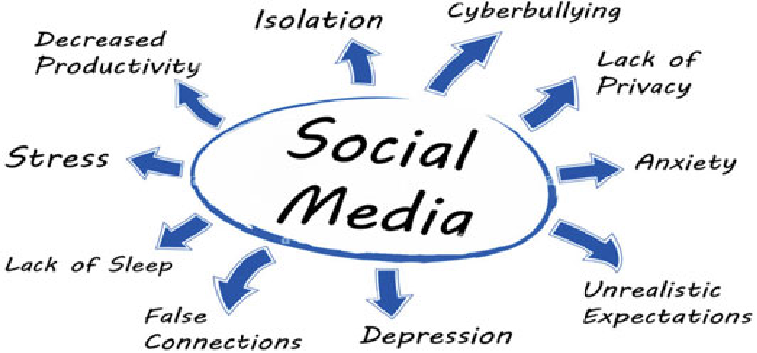

Slide 4
Data of Social Media Effects On Student
Graph: Effects of Social Media on Students (Mental Health)

Slide 5
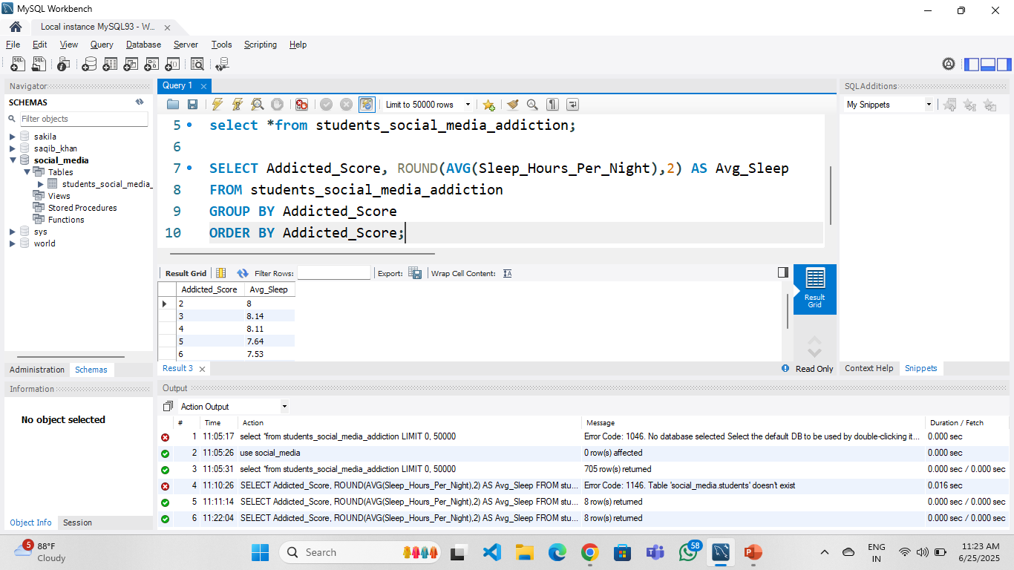
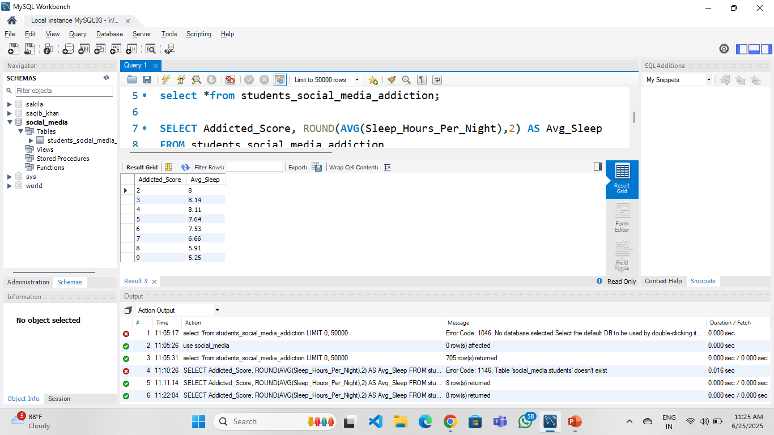
Find the average sleep hours for students grouped by their level of social media addiction.

Slide 6
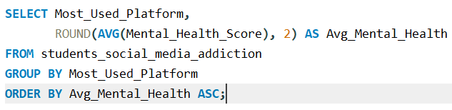
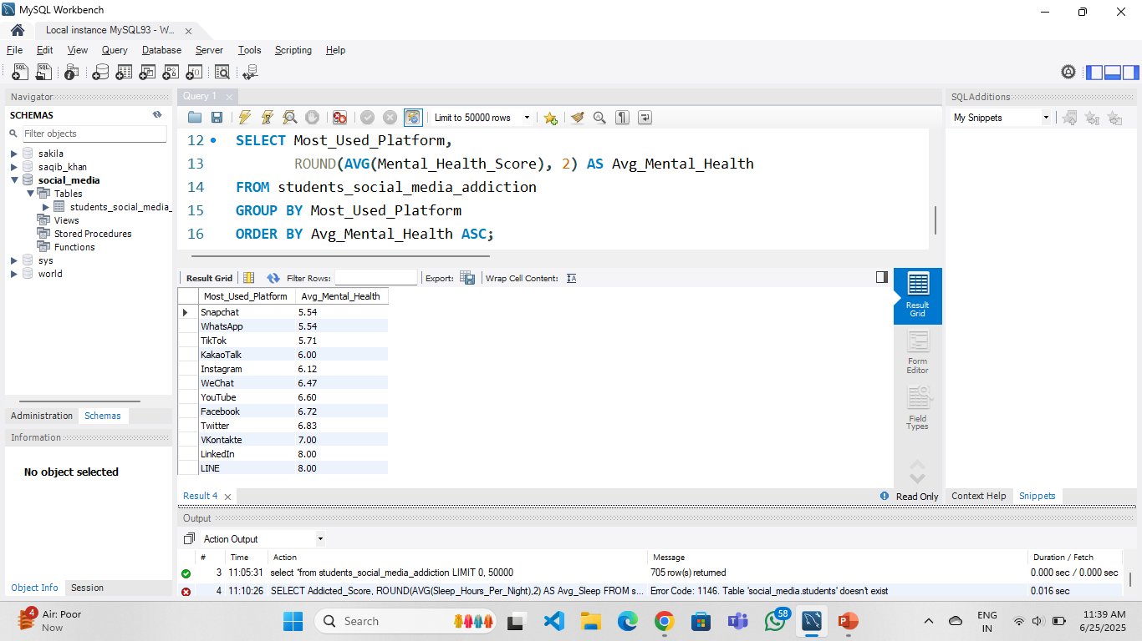
Find the average mental health score of students grouped by the social media platform they use.

Slide 7
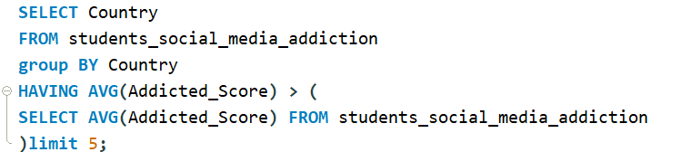
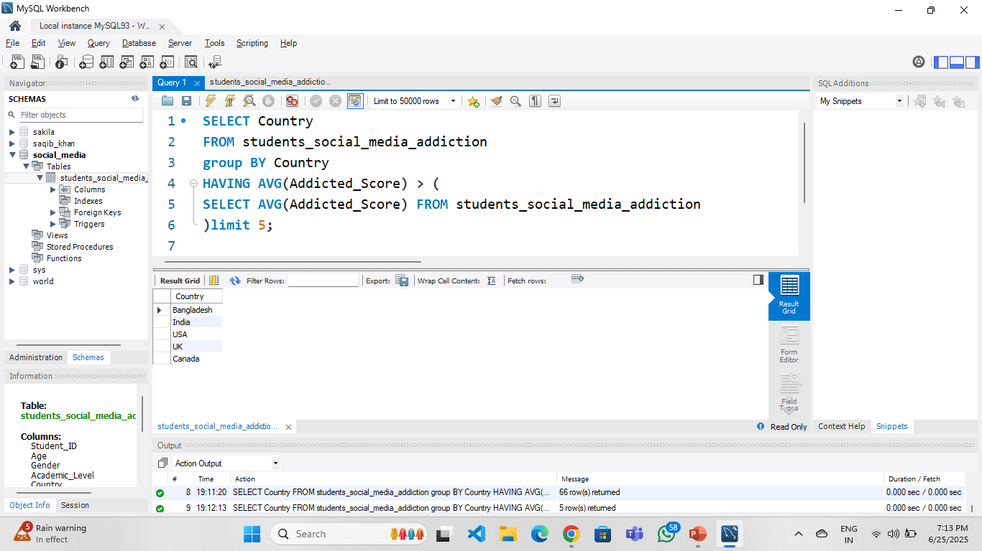
Countries where the average social media addiction level among students is higher than the global average.

Slide 8
Purpose of SQL Study on “Students’ Social Media Addiction”
The purpose of this case study is to analyze the impact of social media usage on students using structured data and advanced SQL queries. Through this case study, we aim to uncover patterns and correlations between social media habits and various factors such as academic performance, sleep hours, mental health, and addiction scores.
Identify students at high risk of social media addiction.
Compare mental health scores across platforms and usage habits.

Slide 9


